Slide 1



Objectives of the Training,
Understanding Quality, Healthcare Quality and
Quality Improvement
Quality Improvement Secretariat
Health Economics Unit, HSD, MoHFW

Slide 2
Learning Objectives:
At the end of the Training the participants will be able to understand
Quality, Healthcare Quality, Quality Improvement (QI) and QI Process
5S and 5S tools
Quality Improvement Committee (QIC) and Work Improvement Team (WIT) with their Terms of References (TOR)
Develop action plan for the selected sections of hospital by the WITs
5S assessment checklist, 5S score card, Facility Level Indicators
Safe Surgery Checklist (SSC)

Slide 3
What is quality?
There is no single definition.
The most durable and widely cited definition of healthcare quality was formulated by the Institute of Medicine (IOM) in 1990:
“Quality consists of the degree to which health services for individuals and populations increase the likelihood of desired health outcomes (quality principles), are consistent with current professional knowledge (professional practitioner skill), and meet the expectations of healthcare users (the marketplace)”.

Slide 4
Cont.
The proper performance according to standards of interventions known to be safe, affordable, and have the ability to produce an impact on morbidity, mortality, disability and malnutrition. (Roemer and Anguilar, WHO 1988 )

Slide 5
cont.
Some other Definitions:
Quality word oriented from Latin word ‘Qualitus’ which means general excellence or distinctive feature.
Quality is a standard of how good something is measured against other similar things or services.
Quality is the totality of the features and characteristics of the product or service that bears on its ability to satisfy the stated or implied needs.
Degree to which a set of inherent characteristics fulfils the requirement.
Quality health care means doing the right thing, at the right time, in the right way, for the right person—and having the best possible results.
The degree of quality is the extent to which the care provided is expected to achieve the most favorable balance of risks and benefits.

Slide 6
Healthcare Quality
“the extent to which health care services provided to individuals and patient populations improve desired health outcomes. In order to achieve this, health care must be safe, effective, timely, efficient, equitable and people-centred” (WHO)
“safe, effective, patient-centered, timely, efficient and equitable.” (IOM)
“as doing the right thing for the right patient, at the right time, in the right way to achieve the best possible results.” (AHRQ)

Slide 7
A working definition
Care that fulfils the needs and expectations of patient
Needs | Expectations
Must be EFFECTIVE Should be SAFE | -Less waiting time -Clean bed -Clean hospital -Clean Toilet -Good behavior -Fan/AC -Sitting arrangement -Well dressed doctors and -Safe food nurses -Quiet / not noisy environment -Safe drinking water

Slide 8
Why quality
Satisfaction-utilization-economy of scales-cost effectiveness
Increases the health status
Poor quality can do harm
Social and economic benefit
Uniformity in process- standards and norms reduce error, waste and cost
Increase motivation –this is what satisfies people
Performance measurement

Slide 9
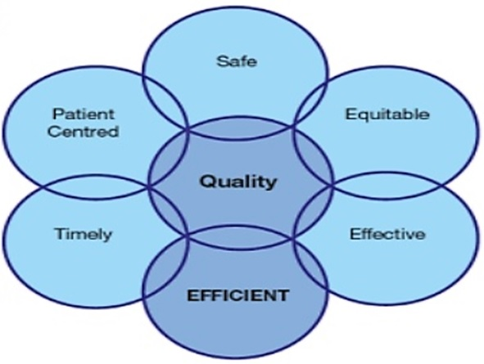
Dimensions of Quality Healthcare

Slide 10
Quality improvement in Healthcare
Quality improvement (QI) consists of systematic and continuous actions that lead to measurable improvement in health care services and the health status of targeted patient groups.

Slide 11
Quality improvement
Approaches:
Quality Assurance: Setting standards/SOPs and monitoring standards /SOPs
Accreditation : Measuring agreed standards and giving certification
Patient satisfaction: Identification of patients dissatisfaction points and eliminating those
Patient safety: Infection prevention, waste management, clinical audit, death audit/review, safe surgery checklist etc.
5S-CQI-TQM
PDCA

Slide 12
“Quality in Healthcare plays a vital Role in Provide Cost effective & Satisfactory care, which automatically results in good promotion of the organization”

Slide 13


